Slide 1
Welcome to Key Club!
September 12th Meeting
Agenda
Introduction
New member info
Video
September events
Take a seat wherever you'd like
Mario

Slide 2
Key Club Pledge
I pledge, on my honor, to uphold the objects of key club international; ​
To build my home, school and community;​
To serve my nation and God;​
And combat all forces which tend to undermine these institutions.​
Marco

Slide 3
2023-24 EBoard Officers
9th grade officers:
11th grade officers:
McKenna Koneval, Vice President
Eemi Toma, Webmaster
Emily Aleardi, Hour Accountant
Fiona Cito, Historian
Eliana Kozlowski, Member Engagement
Ariana Heugh, Member Engagement
10th grade officers:
12th grade officers:
Matteo Durasevic, Event Chair
Olivia Amore, Probation Officer
Delaney Wilson, Treasurer
Mario Quaglia, President
Marco Lefief, Secretary
Mario

Slide 4
Our Mission
Key Club is a community service based club that is focused on building character, promoting leadership, and most importantly, providing service. Throughout the year, Key Club members dedicate a small fraction of their time to make a significant improvement in the community around them.
Mario

Slide 5
Member info
To become an official member of Key Club, a few steps must be completed:
Fill out member application form
Fill out the Code of Conduct form
Pay the PaySchools membership fee in your account
Q: What does the member fee pay for?
Club T-shirt
Key Club International dues
Member card and pin
McKenna

Slide 6
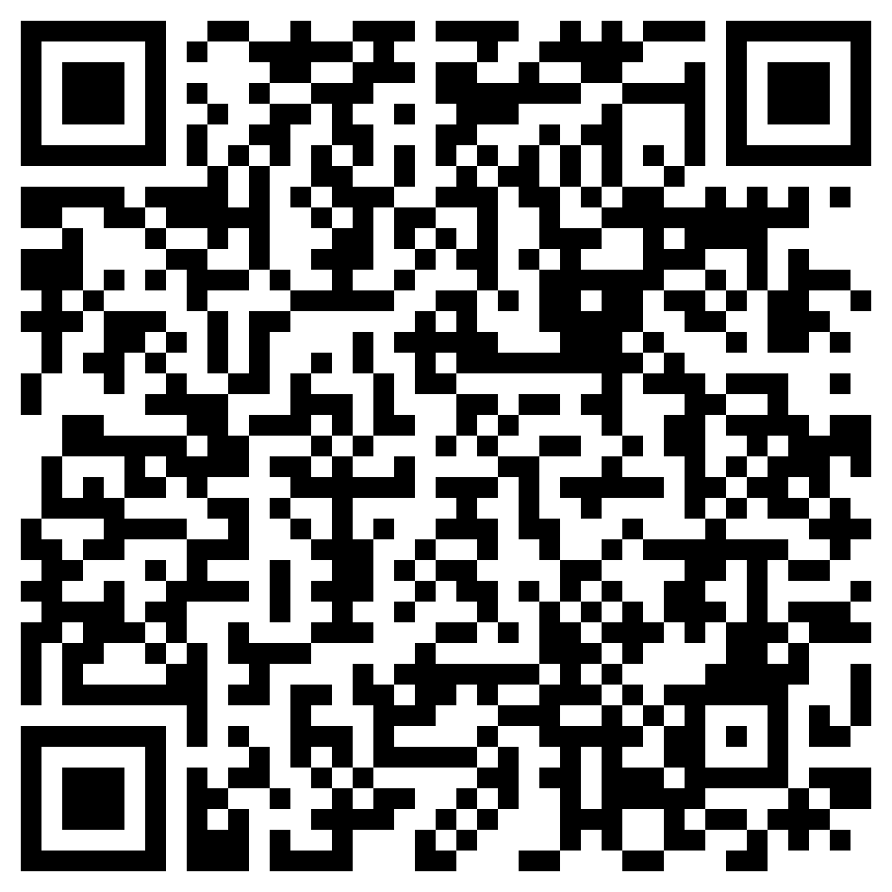
Member info sheet:
PLEASE SCAN AND COMPLETE NOW
Eemi

Slide 7
Remind
Text to 810810:
9th grade: 9key2324
10th grade: 10key2324
11th grade: 11key2324
12th grade: 12key2324
Delaney

Slide 8
How Volunteer Hours Work
16 hours are required for the school year, we recommend completing 2 hours per month
Out of the 16 hours, 6 hours are limited to being "bought"
For "bought hours", $10+ purchases are worth 1 hour, and $20 + purchases are worth 2 hours
QR codes are presented by an EBoard member at each event to submit the hours from that event
Liv

Slide 9
SignUpGenius is how you sign up for all events
To find our SignUpGenius, use the email ldavis@cvs.k12.mi.us
If you need help navigating SignUpGenius, visit our website and watch the informational video
Eliana

Slide 10
Attendance
Please talk to your sports coaches about missing the first few minutes of practice
If problems occur, talk to Mrs. Grimm or Mrs. Davis
Ariana

Slide 11
Video link
Mario

Slide 12
Recurring Events
Ojibwa SACC
Cheyenne SACC
Teacher Helper
Activity-Leader for SACC Program @ Cheynne Elementary
3:30 –4:30pm
Monday through Friday
More info on signupgenuis
Activity-Leader for SACC Program @ Cheyenne Elementary
3:25-4:25 Monday through Friday
More info on signupgenuis
Helping a teacher after school
To get your hours you will need to fill out the Teacher helper form and have the teacher sign
Form on website
Matteo

Slide 13
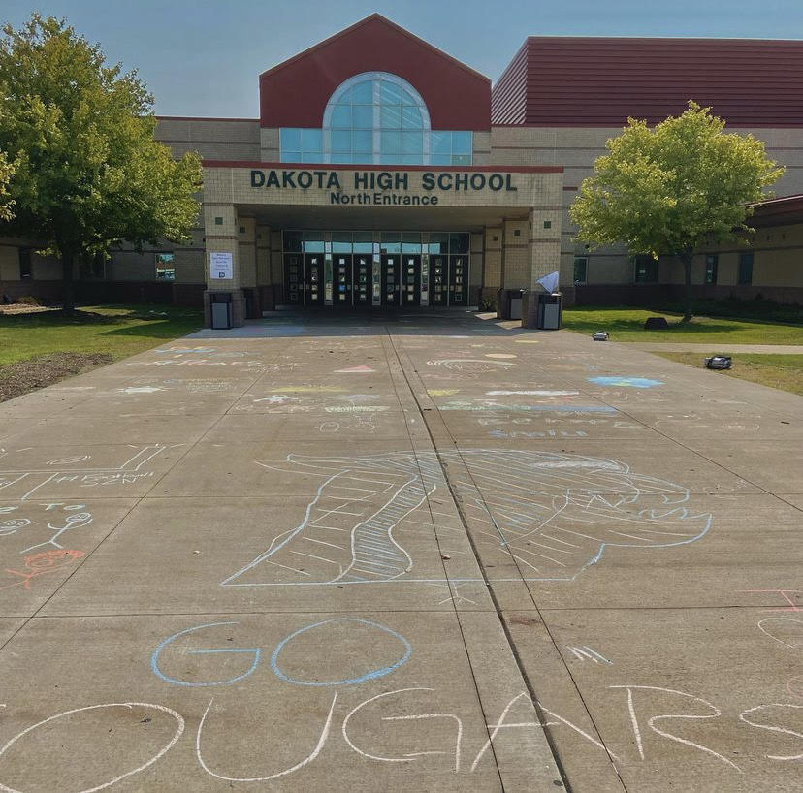
Back to School Chalking
We will be chalking positive messages at the school entrances
Wednesday, September 13th 2:15-3:15
*PLEASE BRING YOUR OWN CHALK*
McKenna

Slide 14
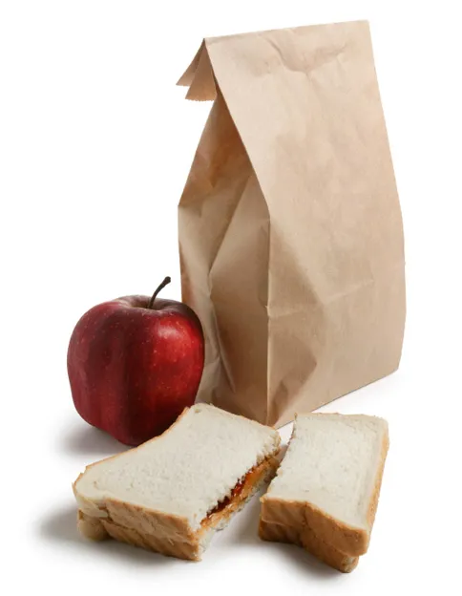
Bagged Lunches for the Homeless
We will be making 120+ bagged lunches for a homeless shelter in our community.
Supply drop off:
Monday, September 25th 6:50-7:10 AM
Lunch assembling:
Tuesday, September 26th
2:15-3:15 PM
McKenna

Slide 15
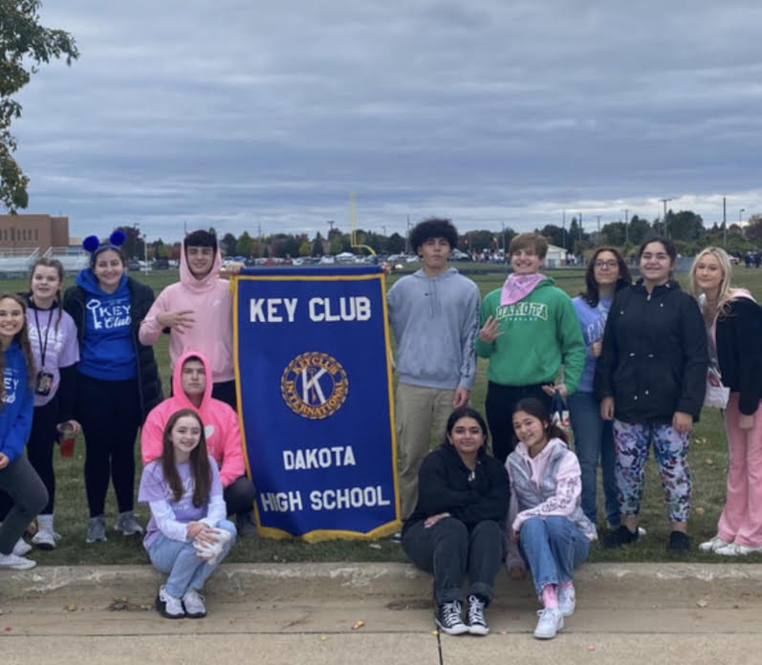
Homecoming Parade
Key Club will be walking in the homecoming parade!
September 29th, 4:30 PM
*YOU MUST BRING A LARGE BAG OF INDIVIDUALLY WRAPPED CANDY*
The event will be worth 2 hours with the purchase of candy included.
Location details will be sent to participant's school emails
McKenna

Slide 16
Additional Info
More in depth information on each event will be on sign up genius
The events will be posted on sign up genius at 4 PM today
Emily

Slide 17
Important Information
All club information can be found in both our Instagram and our Weebly.
Make sure to follow our Instagram, new hour opportunities, members of the month, and more will be posted there!
Instagram: @dakotakeyclub
Website: dakotakeyclub.weebly.com
Fiona

Slide 18
Thank you for coming!
Our next meeting is Tuesday, October 3rd
Mario

