Slide 1
Key Club
NOVEMBER 10TH
2020-2021

Slide 2
Today's Agenda
Sign up genius
Hour Logs
Upcoming Events
T-shirt Pickup
Social Media
Maddie

Slide 3
Sign Up Genius
To get to our sign ups go to signupgenius.com
Click find and then type in ldavis@cvs.k12.mi.us
(lowercase L)
All events will be posted after todays meeting!
Lindsey

Slide 4
Have not paid DUES on powerschool
Have not Filled out a member info sheet
Sammantha Allous
Bella Austin
Eli Bellew
Melissa Bilica
Emma Bourgeois
Taylor Burnham
Bianca Cabarios
Beatrice Evgenieva
Bryan Hagyard
Lauryn Hiemke
Olivia Hilton
Ramina Kolami
Serena Palushaj
Ava Smith
Isabella Soporean
Lorena Storaci
Eemi Toma
Elle Warnack
Jaida Young
Mela Cipriano
Reagan Detzler
Alyse Garrisi
Anthony Djokic
Sophia Milana
Benedeta Kalaj
Ava Miller
Kamila Pietrzyk
Mackenzie Schlitt
Austin Yerke
You cannot get a shirt until you pay!
https://docs.google.com/forms/d/e/1FAIpQLSdqRY3JPgosdzw4SsfgYldduplXdVWQOFfOv8K3wqUhwjHRkA/viewform
ALSO ON WEBSITE!
Alina

Slide 5
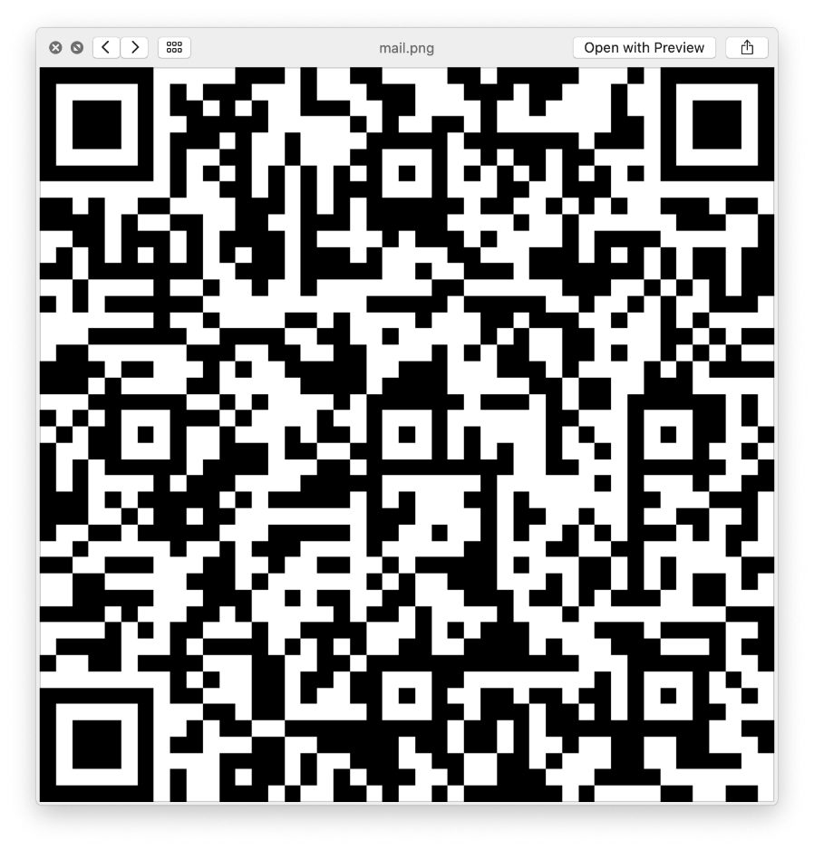
Hour logs(Covid Friendly)
You will no longer need to bring your hour logs to events or get signatures
Instead, we will now have a QR code to scan at every event which will automatically give you credit for hour
EVERYONE NEEDS TO SCAN THIS CODE TO LOG THEIR OCTOBER HOURS!
Please make sure to include your first and last name or your hours will not be counted
Sophia

Slide 6
Hours
You will need two hours every month
Please try not to sign up for more than 2 a month so we can provide hours to all members
When signing up for events, include the amount of hours you will be completing in the comment section on sign up genius
Please contact zhangk2003@yahoo.com or sophiawengg2@gmail.com with any questions!
Kelly

Slide 7
New Event Requirements
K
E
N
D
Y
L
You must wear a mask and stay 6 feet apart from others at every event!

Slide 8
YOU ARE NOW ALLOWED TO HAVE 10
“BOUGHT” HOURS DUE TO THIS
YEAR’S CIRCUMSTANCES!
Alina

Slide 9
Upcoming events
November 12th,17th,or 19th T-shirt Pickup
November 15th Chalk Drawings(Maddie)
November 17th Baked Goods (Mia & Sydney)
November 19th Nursing Home Cards (Taylor)
Friends of Foster Care donations collected on November 30th (Samantha)
Friends of Foster Care Volunteering November/December (Maddie)
December 13th Letters to Santa (Maddie)
Sydney

Slide 10
T-Shirt Pickup
T-shirt pick up is on November 12th, 17th, or 19th
2:30-3:00 at the north entrance
Please come up to the tables!

Slide 11
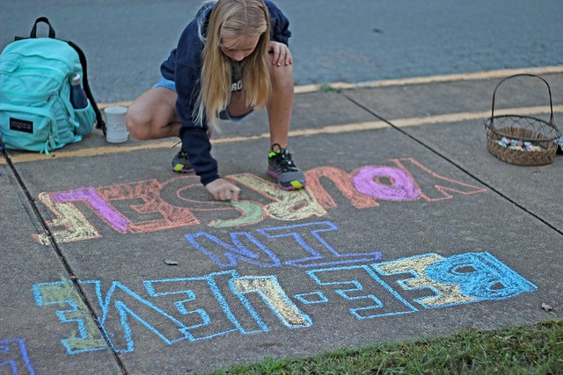
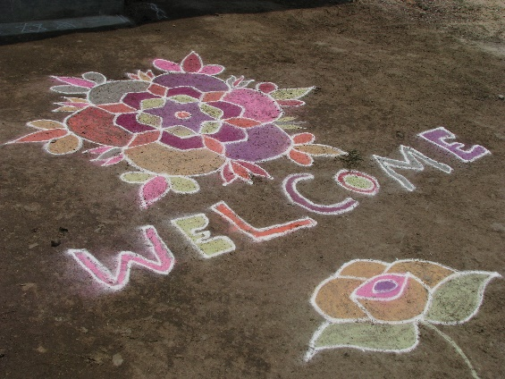
Chalk drawings
November 15th from 5:00-6:00
Meet at the north entrance
Bring your own chalk we are not allowed to share between members!
We will have students writing positive messages or drawing simple pictures on the sidewalk of every entrance to the main building and 9th grade center
Spread positivity to teachers and thank them!
Maddie
This Photo by Unknown Author is licensed under CC BY

Slide 12
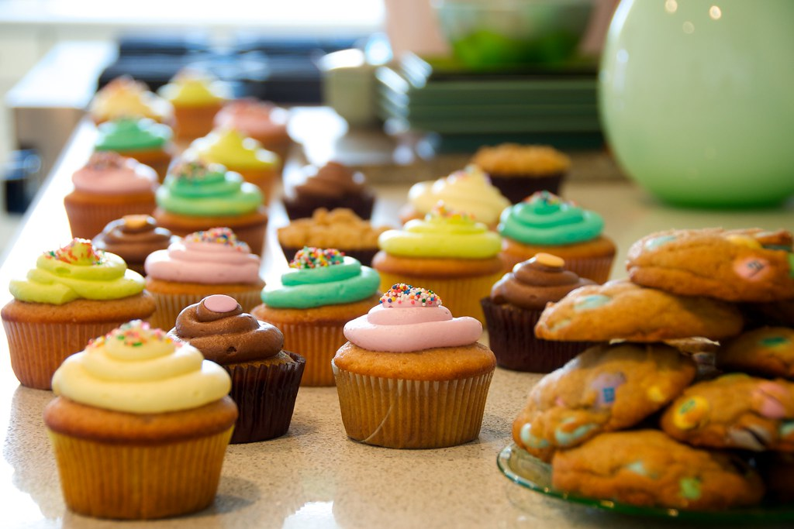
Baked Goods
Drop off November 17th at the north entrance from 2:30-3:00
2 dozen=1 hour
MUST BE INDIVDUALLY PACKAGED AND HOMEMADE
Donations are made to the Macomb County correctional officers
Mia

Slide 13
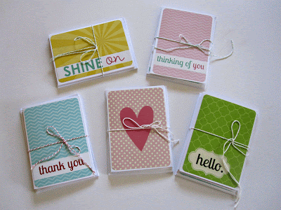
Nursing Home cards
Collected on November 19th from 2:30-3:00 at the north entrance
3 cards=1 hour
Go to loveforourelders.org to see how to write the letters
You do not have to ship them
I will collect them from you on November 19th!
Taylor

Slide 14
Friends Of Foster Kids
Friends of Foster Kids is an organization that helps provide for kids in foster care.
This year you can make a teens Christmas very special and become an Angel. Teens are at the highest rate to be in prolonged foster care.
It is important to volunteer and buy presents because these are the only gifts these teens will receive for the entire year.
The sign up will be available from November 10th- November 30th. I will be available November 30th from 2:30- 3 for donation drop off. You can drop off gifts in the office before November 30th in the Key Club box. ALL PRESENTS MUST BE RECEIVED BY NOVEMBER 30TH.

Slide 15
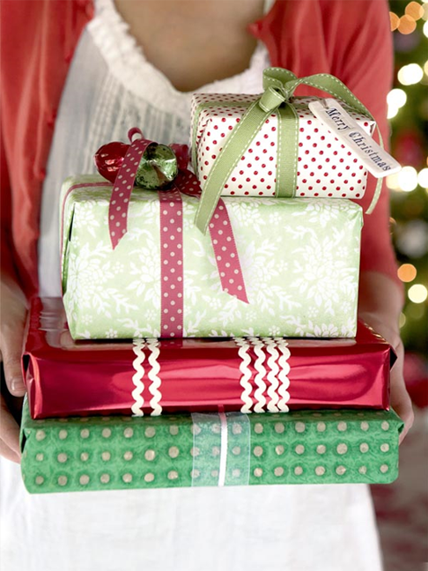
FRIENDS OF FOSTER KIDS
At the Friends of Foster Kids Location
Have to be at least 14 years old
Signups through November and December
Needs volunteers to help wrap gifts, organize donations, and unload donations from cars
If you are volunteering, they would like you to bring boxes or wrapping paper if you are able to
Please be mindful of when you are signing up and check your email for possible cancellations
Maddie

Slide 16
Follow our twitter and Instagram!
@dakotakeyclub
Our website is:
dakotakeyclub.weebly.com
Bella

Slide 17
See you at our next meeting on December 1st!
Don’t forget the sign-ups for all November events will be posted on Signup Genius after this meeting!
Maddie

