Slide 1
Welcome to Key Club!
April 9th Meeting
Agenda
April Events
Members of the Month
Elections
Take a seat wherever you'd like!
Mario

Slide 2
Key Club Pledge
I pledge, on my honor, to uphold the objects of key club international; ​
To build my home, school and community;​
To serve my nation and God;​
And combat all forces which tend to undermine these institutions.​
Marco

Slide 3
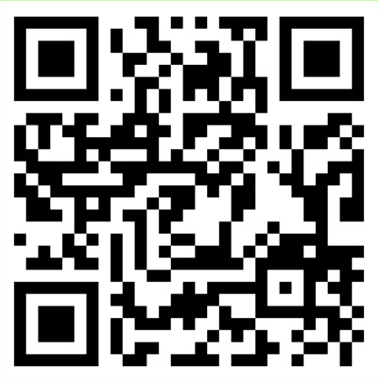
Remind and Band
BAND QR Code
Remind Codes
Text to 810810:
9th grade: 9key2324
10th grade: 10key2324
11th grade: 11key2324
12th grade: 12key2324
Delaney

Slide 4
Volunteer Hour Deductions
Members are dropping hours without getting replacements.
If you are a no-show at an event, the amount of hours you signed up for will be a deduction.
There are NO warnings.
Check your schedule before signing up.
Use band to ask for someone to take your shift.
If they do you, do not have to delete your name off the sign up.
Emily

Slide 5
Reocurring Events Part 1
Ojibwa SACC
Cheyenne SACC
Recycling
With Ms. Comoford
Use Key Club Sign up, NOT the general Sign-up
2:20-3:30
Monday, 4/15 & 29
Activity-Leader for SACC Program @ Ojibwa
Elementary
3:30 –4:30pm
Monday through Friday
More info on signupgenuis
Activity-Leader for SACC Program @ Cheyenne Elementary
3:30-5:00 Monday through Friday
More info on signupgenuis
Matteo

Slide 6
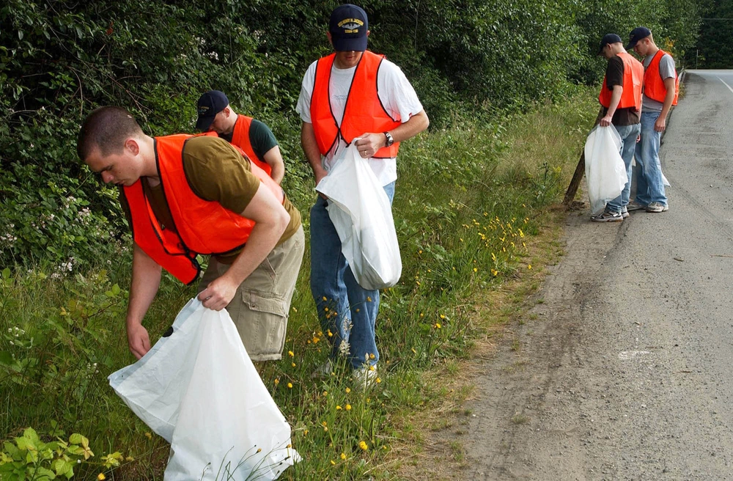
Adopt a Road Clean Up
Sunday, April 14th from 8:00am to 10:00am
You will be cleaning along the north side of 21 Mile Road
Please have your parent sign a permission slip at the Security Desk
You are required to watch a safety video before participating. Link is in SignUpGenius
We will email you about a meeting place
Marco

Slide 7
Earth Day Chalking
Wednesday April 10th from 2:30pm to 3:30pm
We will be writing/drawing messages related to Earth Day on the North and Main Entrance
You are responsible for finding your own transportation
In the event of rain, chalking will be moved back to April 16th
Marco

Slide 8
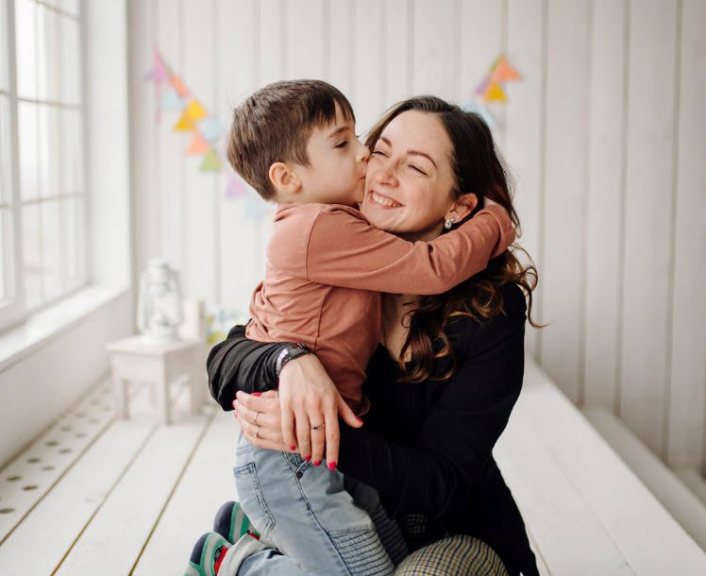
Mother Son Night of Fun
Wednesday April 24th 4:30pm to 8:00pm
Dave and Busters off Hall Road
Event ran by Macomb Township Parks and Recreation
Marco

Slide 9
Teacher Appreciation Week
The first event is a donation. It will be held Monday April 29th before school
Drop off supplies at the Atrium
We are looking for sticky notes, microwaveable popcorn, Extra Gum, or Vaseline Lip Balm
Specific quantities will be in the sign-up
There’s also a separate signup to donate $10 gift cards
The second event will be Tuesday April 30th after school in Mrs. Davis's room
We will pack our supplies into bags with cards in them
Marco

Slide 10
Iroquois Practice Meet
Wednesday April 24th 3:30pm to 6:00pm
You will help the Iroquois Track Team during their meets
There will be other track meets throughout May
Marco

Slide 11
Baked Goods Donation
Friday April 19th after school
All goods donated will go to the Macomb Township Fire Department
1 good = 1 bought hour
Marco

Slide 12
Michigan Senior Olympics
Sunday April 14th 8:30 am to 12:00 pm and 12:00 pm to 5:00 pm
You will be helping out with the volleyball game
Located at Elite Sportsplex in Waterford Township

Slide 13
Members of the Month
Corey
Cojocar
Andjela
Elezovic
Eliana

Slide 14
Additional Info
More in depth information on each event will be on sign up genius
The events will be posted on sign up genius at 4 PM today and on BAND
Eemi

Slide 15
Elections
Elections for the 2024-2025 school year are April 9th! Elected positions are the following:
President
Vice President
Secretary
Treasurer
Historian
Mario

Slide 16
Applied Positions
If you did not win your preferred position in the election or you did not run in the election, there is still another chance to join E-Board. Applied positions exist, where you fill out an application form to be reviewed.
Applications will be available after our meeting TODAY!!
McKenna

Slide 17
Election Process
Those nominated for each position will read their speech.
Following there will be a QR Code that will direct you to your ballot.
Choose one candidate who you feel is fit.
SENIORS DO NOT VOTE
The winner will be announced and those who were not elected will move on to the next position and the process will start again.
Mario

Slide 18
Elections
President Speeches
Mario

Slide 19
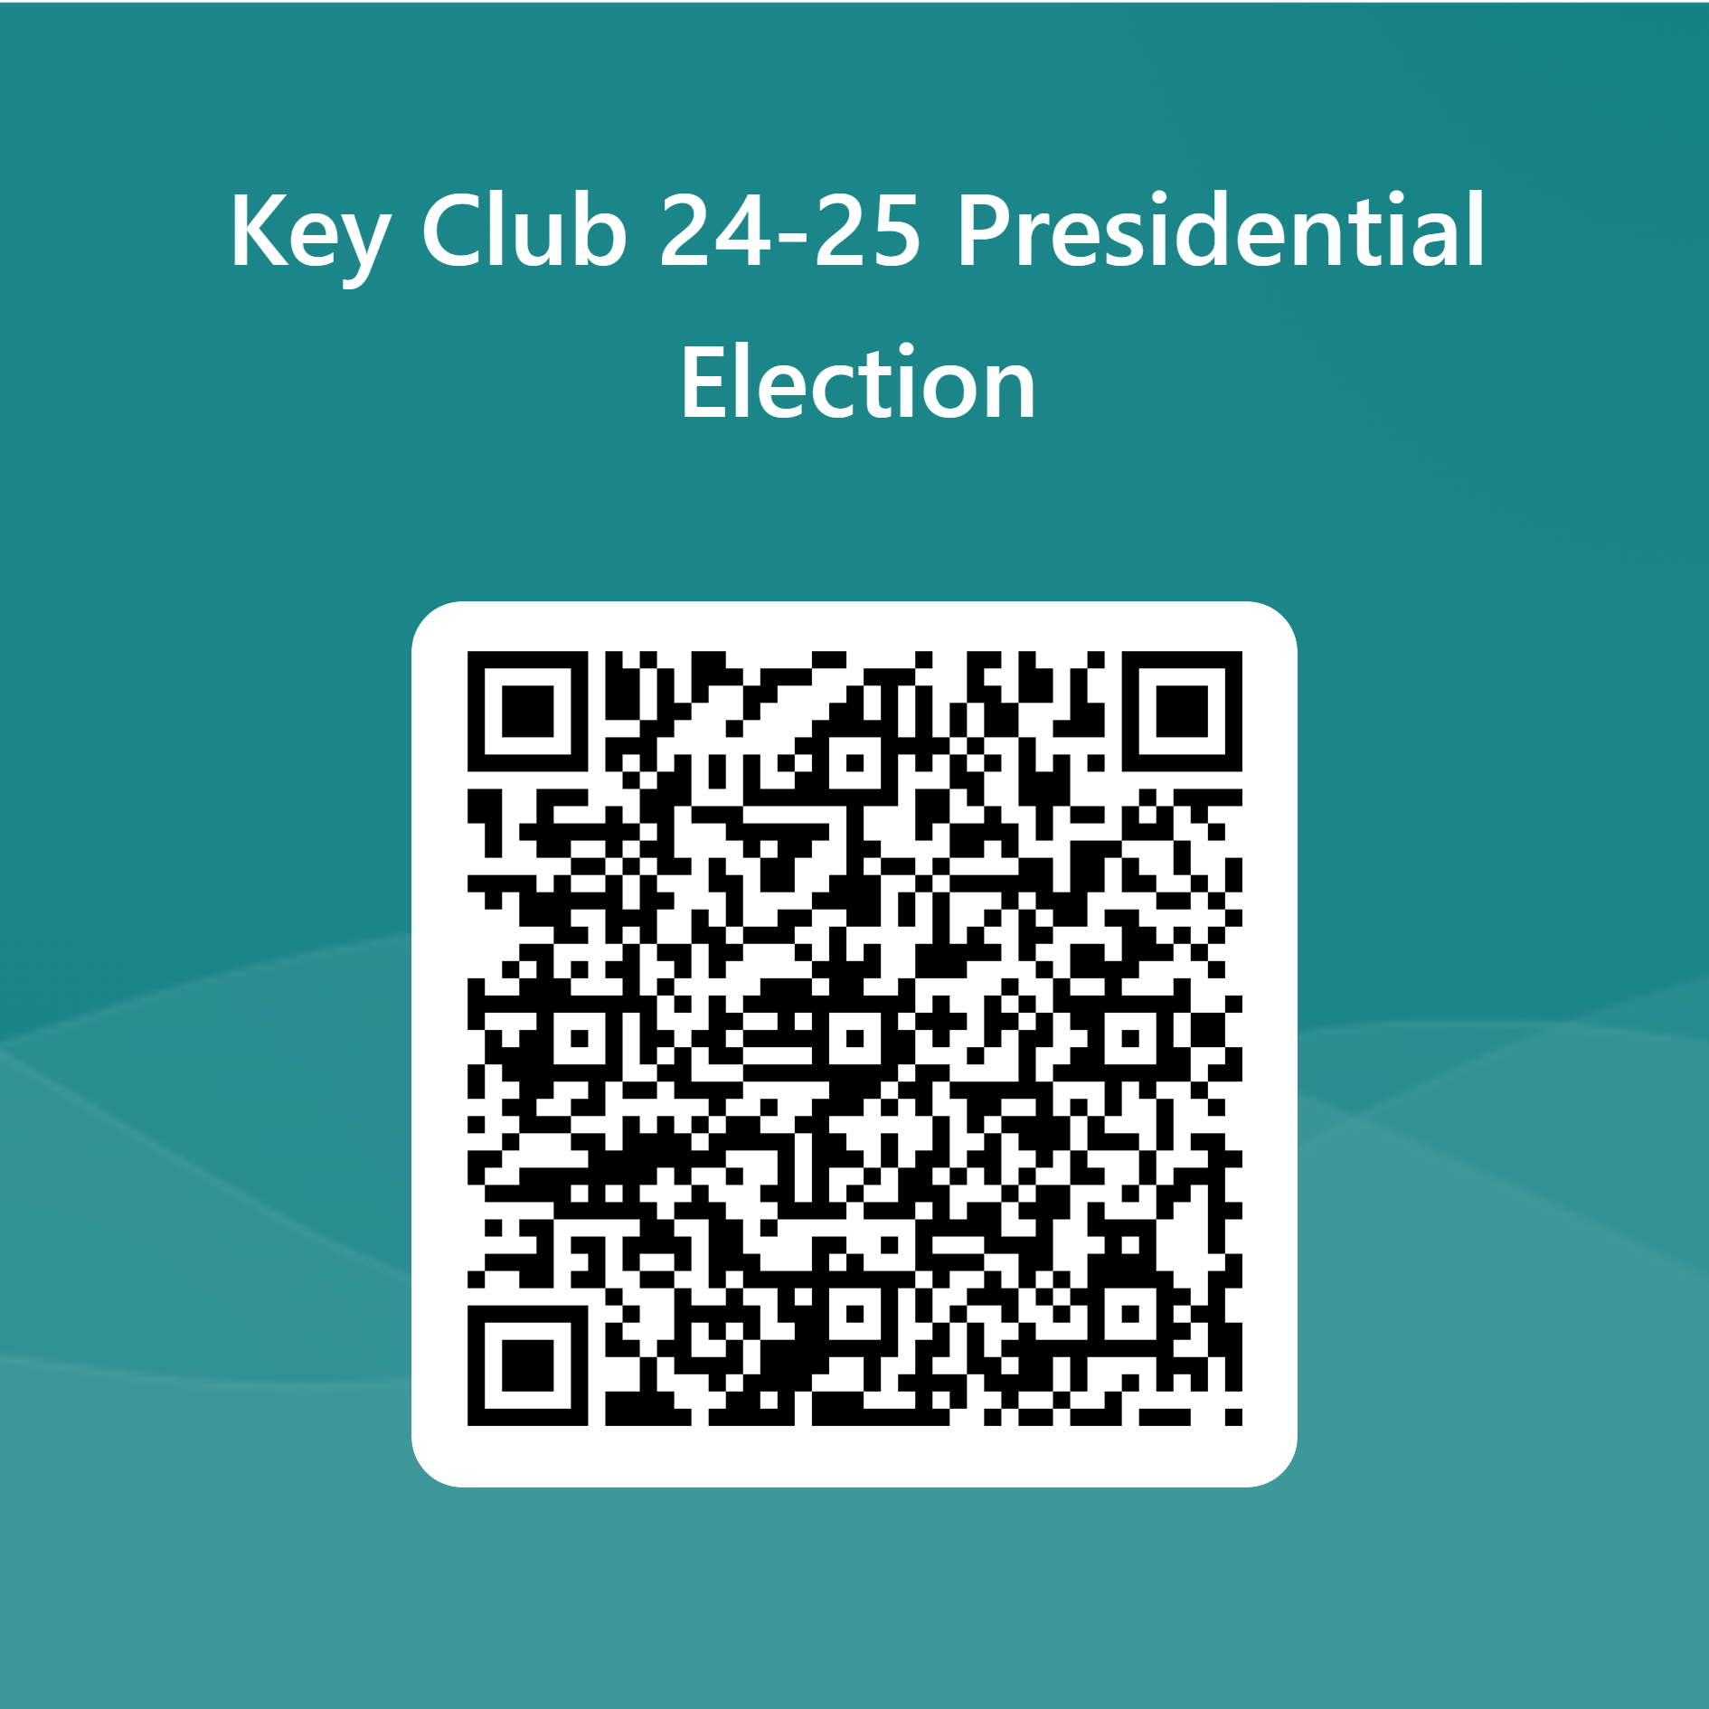
President
Mario
Mario

Slide 20
Elections
Vice
President Speeches
Mario

Slide 21
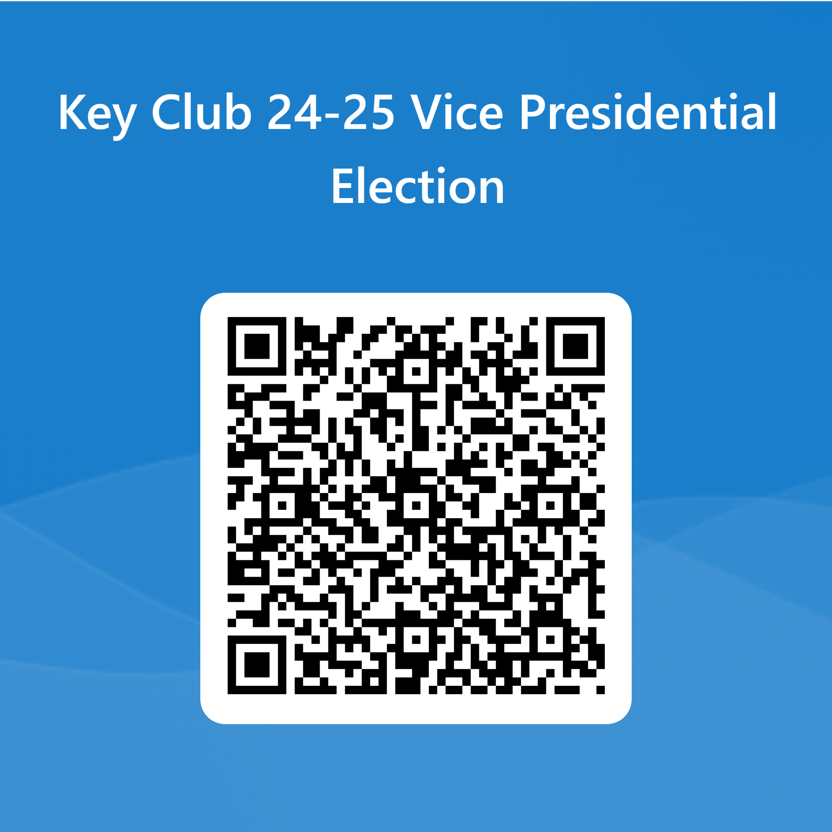
President
Mario
Mario

Slide 22
Elections
Secretary Speeches
Mario

Slide 23
President
Mario
Mario

Slide 24
Elections
Treasurer Speeches
Mario

Slide 25
President
Mario
Mario

Slide 26
Elections
Historian Speeches
Mario

Slide 27
President
Mario
Mario

Slide 28
Cord Applications
Seniors! As you leave today make sure you picked up the Cord Application. This must be completed and turned into to Ms. Davis or Ms. Grimm by April 23rd.
Delaney

Slide 29
Officer Applications
If you did not run or did not get your preferred position you can still be apart of E-Board! Pick up an applied officer application and return it to Ms. Davis or Ms. Grimm by April 23rd.
Delaney

Slide 30
Important Information
All club information can be found in both our Instagram and our Weebly.
Make sure to follow our Instagram, new hour opportunities, members of the month, and more will be posted there!
Instagram: @dakotakeyclub
Website: dakotakeyclub.weebly.com
Fiona

Slide 31
Thank you for coming!
Please make sure to check out at your class table and get your shirt!
Our next meeting is on April 9th
in the Auditorium
Mario

Slide 32
Key Club is using the Band App!
Band is an app where all signups are easier to access.
The app allows you to be notified when new sign-ups are posted
Important information can be announced easier
Mario

Slide 33
How it Works
All Sign-ups are easily accessible and all in one place
Be able to ask questions and get quick responses
Be able to ask for people to take your spots if you can't make it
Easy access to updates
https://youtu.be/0ZSpGNeWR6E
McKenna

Slide 34
Join the Band!
Scan the QR Code
Download the Band App
Create an account
Join the Band
If it doesn't work in here the code will be on the website and on the hand out.
Mario

Slide 35
2023-24 EBoard Officers
9th grade officers:
11th grade officers:
McKenna Koneval, Vice President
Eemi Toma, Webmaster
Emily Aleardi, Hour Accountant
Fiona Cito, Historian
Eliana Kozlowski, Member Engagement
Ariana Heugh, Member Engagement
10th grade officers:
12th grade officers:
Matteo Durasevic, Event Chair
Olivia Amore, Probation Officer
Delaney Wilson, Treasurer
Mario Quaglia, President
Marco Lefief, Secretary

Slide 36
How Volunteer Hours Work
16 hours are required for the school year, we recommend completing 2 hours per month
Out of the 16 hours, 6 hours are limited to being "bought"
For "bought hours", $10+ purchases are worth 1 hour, and $20 + purchases are worth 2 hours
QR codes are presented by an EBoard member at each event to submit the hours from that event
Liv

Slide 37
Attendance
Please talk to your sports coaches about missing the first few minutes of practice
If problems occur, talk to Mrs. Grimm or Mrs. Davis
Ariana

Slide 38
Our Mission
Key Club is more than just collecting hours.
Volunteering is something you want to do to help out, it is not a job.
Support our local community.
Enjoy what you do. Do events that means something to you!
Mario

