Slide 1
Welcome to Key Club!
March 5th Meeting
Agenda
March Events
Members of the Month
Take a seat wherever you'd like!
Mario

Slide 2
Toilet Paper Rolls/Newspaper Donations
Thank you for bringing these in! They will be used for an event this month.
We will be making dog enrichment treats for the Macomb Humane Society!
Ariana

Slide 3
Key Club Pledge
I pledge, on my honor, to uphold the objects of key club international; ​
To build my home, school and community;​
To serve my nation and God;​
And combat all forces which tend to undermine these institutions.​
Marco

Slide 4
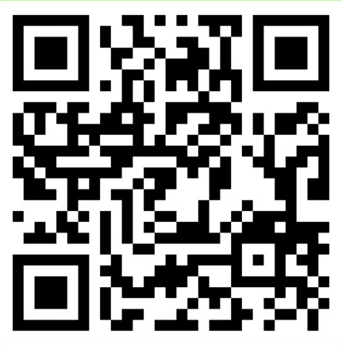
Remind and Band
BAND QR Code
Remind Codes
Text to 810810:
9th grade: 9key2324
10th grade: 10key2324
11th grade: 11key2324
12th grade: 12key2324
Delaney

Slide 5
Volunteer Hour Deductions
Members are dropping hours without getting replacements.
If you are a no-show at an event, the amount of hours you signed up for will be a deduction.
There are NO warnings.
Check your schedule before signing up.
Use band to ask for someone to take your shift.
If they do you, do not have to delete your name off the sign up.
Emily

Slide 6
Reocurring Events Part 1
Ojibwa SACC
Cheyenne SACC
Recycling
With Ms. Comoford
Use Key Club Sign up, NOT the general Sign-up
2:20-3:30
Monday, 2/26
Activity-Leader for SACC Program @ Ojibwa
Elementary
3:30 –4:30pm
Monday through Friday
More info on signupgenuis
Activity-Leader for SACC Program @ Cheyenne Elementary
3:30-5:00 Monday through Friday
More info on signupgenuis
Matteo

Slide 7
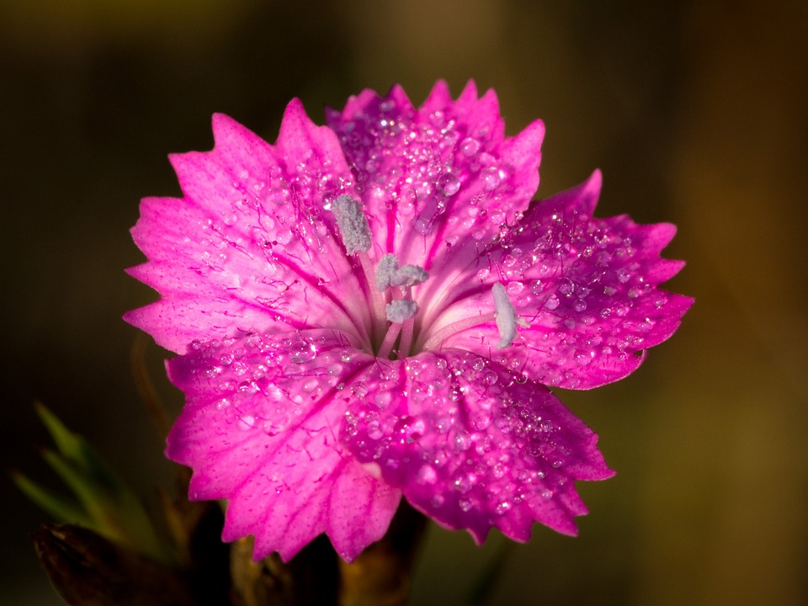
Dakota Spring Craft Show
Friday, March 15th after school
Saturday, March 16th all day
Slots are about 3-4 hours in length
There are many slots for this event, so please consider signing up!
Sign up will be posted at 4:00pm
Liv

Slide 8
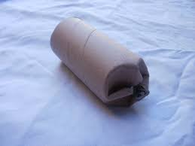
Dog Treat Making and Donations
We will be collecting dog treats on Thursday, March 22nd after school in the atrium by the brick wall
We will be making the dog treats after school in Mrs. Grimm's room on Tuesday, March 26th
These will be separate sign ups! Posted at 4:00pm today with more info
These will be going to the Macomb Humane Society to dogs in shelters.
Liv

Slide 9
Chippewa Valley Science Olympiad
There will be 5 different opportunities to volunteer for Science Olympiad this month
March 2nd, 9th, 16th, 18th, and 19th
Sign-ups will be posted at 4pm!
Liv

Slide 10
Turning Point Donations
Turning Point is a shelter for teens who have suffered from violence or trafficking. They are in need of clothing and toiletries to provide for the children.
Collection will be on Thursday, March 22nd after school in the atrium by the brick wall.
This counts as bought hours
Sign up will be posted at 4:00pm
Liv

Slide 11
Members of the Month
Jacob Oltersdorf
Sophia Martin
Eliana

Slide 12
Additional Info
More in depth information on each event will be on sign up genius
The events will be posted on sign up genius at 4 PM today and on BAND
Eemi

Slide 13
Elections
Elections for the 2024-2025 school year are April 9th! Elected positions are the following:
President
Vice President
Secretary
Treasurer
Historian
Mario

Slide 14
Roles of E-Board
Before we get into the election process, each E-Board member will explain their role on the Key Club board.
Mario

Slide 15
Applied Positions
If you do not win your preferred position in the election or you do not want to run in the election, there is still another chance to join E-Board. Applied positions exist, where you fill out an application form to be reviewed.
Applications will be available after our meeting Tuesday, April 9th
McKenna

Slide 16
Nominations
To run for a position, you must be nominated for the position by another member, following a "second" of the nomination by another member.
Liv

Slide 17
We will now start nominations for the following positions:
President
Vice President
Secretary
Treasurer
Historian
Liv

Slide 18
Cord Applications
SENIORS!! Graduation is in 3 months!
It's time to wrap up your final Key Club Hours and meet your cord requirements!
Applications will be available next meting.
Grimm and Davis

Slide 19
Important Information
All club information can be found in both our Instagram and our Weebly.
Make sure to follow our Instagram, new hour opportunities, members of the month, and more will be posted there!
Instagram: @dakotakeyclub
Website: dakotakeyclub.weebly.com
Fiona

Slide 20
Thank you for coming!
Please make sure to check out at your class table and get your shirt!
Our next meeting is on April 9th
in the Auditorium
Mario

Slide 21
Key Club is using the Band App!
Band is an app where all signups are easier to access.
The app allows you to be notified when new sign-ups are posted
Important information can be announced easier
Mario

Slide 22
How it Works
All Sign-ups are easily accessible and all in one place
Be able to ask questions and get quick responses
Be able to ask for people to take your spots if you can't make it
Easy access to updates
https://youtu.be/0ZSpGNeWR6E
McKenna

Slide 23
Join the Band!
Scan the QR Code
Download the Band App
Create an account
Join the Band
If it doesn't work in here the code will be on the website and on the hand out.
Mario

Slide 24
2023-24 EBoard Officers
9th grade officers:
11th grade officers:
McKenna Koneval, Vice President
Eemi Toma, Webmaster
Emily Aleardi, Hour Accountant
Fiona Cito, Historian
Eliana Kozlowski, Member Engagement
Ariana Heugh, Member Engagement
10th grade officers:
12th grade officers:
Matteo Durasevic, Event Chair
Olivia Amore, Probation Officer
Delaney Wilson, Treasurer
Mario Quaglia, President
Marco Lefief, Secretary

Slide 25
How Volunteer Hours Work
16 hours are required for the school year, we recommend completing 2 hours per month
Out of the 16 hours, 6 hours are limited to being "bought"
For "bought hours", $10+ purchases are worth 1 hour, and $20 + purchases are worth 2 hours
QR codes are presented by an EBoard member at each event to submit the hours from that event
Liv

Slide 26
Attendance
Please talk to your sports coaches about missing the first few minutes of practice
If problems occur, talk to Mrs. Grimm or Mrs. Davis
Ariana

Slide 27
Our Mission
Key Club is more than just collecting hours.
Volunteering is something you want to do to help out, it is not a job.
Support our local community.
Enjoy what you do. Do events that means something to you!
Mario

