Slide 1
Agenda
Reminders
Celebration
May 23rd
Meeting
Lindsey

Slide 2
Key Club Pledge
I pledge, on my honor, to uphold the objects of key club international;
To build my home, school and community;
To serve my nation and God;
And combat all forces which tend to undermine these institutions.
Kendyl

Slide 3
Hour Log Reminders
16 HOURS BEFORE THE END OF THE YEAR
Use the full event name in the form
If you missed a QR code, ask an officer at a meeting
Only 5 bought hours allowed (ex: canned food drive)
Sign up for things you are interested in (if you don’t like kids don’t do SACC)
Email Julia with any hour questions 1760019821@cvs.k12.mi.us
Kylie

Slide 4
Reoccurring Events
Ojibwa SACC
Active Leader for SACC Program @ Ojibwa Elementary
3-5pm Monday through Friday
Lead a sport, craft or game
More info on signupgenius
Cheyenne SACC
Active Leader for SACC Program @ Cheyenne Elementary
3-5pm Monday through Friday
Lead a sport, craft, or game
More info on signupgenius
Teacher Helper
Helping a teacher after school
To get your hours you will need to fill out Teacher helper for and have teacher sign
Form on website
Nate

Slide 5
Members of the Month
Lanee Simons
Jeffery Garrant
Alani Green
Eliana

Slide 6
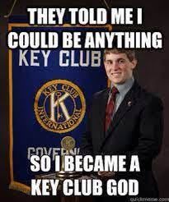
LAST MEETING
Thank you for being here and being a part of Key Club… Seniors have a great summer!!
Lindsey

Slide 7
Follow Our Socials!!
Check Out our website at dakotakeyclub.weebly.com
Instagram @DakotaKeyClub
Twitter @DakotaKeyClub
Liv

Slide 9
Absences
Please talk to your sports coaches about missing the first few minutes of practice
If problems occur, talk to Mrs. Grimm or Mrs. Davis
Bella

Slide 10
Remind
Text to 81010
Freshmen: @acd96g
Sophomores: @9e4eh3
Juniors @b3k792
Seniors: @4hh4b2
Eliana

Slide 11
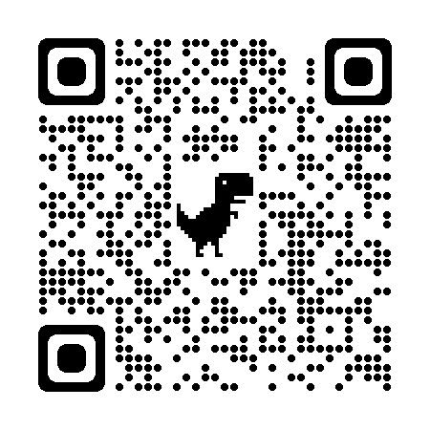
BOOSTER CONCESSIONS
Getting parent volunteers allows the money donations to go to KEY CLUB
Eemi

Slide 12
Signup genius
SignupGenius is how you sign up for all events
To find our SignupGenius, use the email ldavis@cvs.k12.mi.us
Mario

