Slide 1
Agenda
Reminders
March events
Nominations
Groups
March 21st
Meeting
Lindsey

Slide 2
Key Club Pledge
I pledge, on my honor, to uphold the objects of key club international;
To build my home, school and community;
To serve my nation and God;
And combat all forces which tend to undermine these institutions.
Kendyl

Slide 3
Signup genius
SignupGenius is how you sign up for all events
To find our SignupGenius, use the email ldavis@cvs.k12.mi.us
bella

Slide 4
Remind
Text to 81010
Freshmen: @acd96g
Sophomores: @9e4eh3
Juniors @b3k792
Seniors: @4hh4b2
Liv

Slide 5
Reoccurring Events
Ojibwa SACC
Active Leader for SACC Program @ Ojibwa Elementary
3-5pm Monday through Friday
Lead a sport, craft or game
More info on signupgenius
Cheyenne Sacc
Active Leader for SACC Program @ Cheyenne Elementary
3-5pm Monday through Friday
Lead a sport, craft, or game
More info on signupgenius
Teacher Helper
Helping a teacher after school
To get your hours you will need to fill out Teacher helper for and have teacher sign
Form on website
Nate

Slide 6
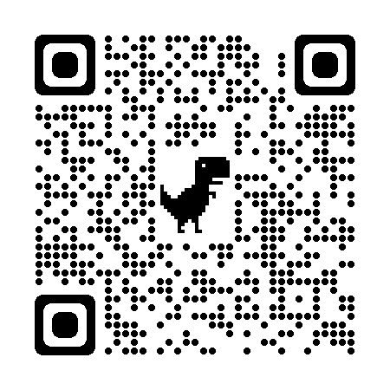
BOOSTER CONCESSIONS
Getting parent volunteers allows the money donations to go to KEY CLUB
Eemi

Slide 7
Hour Log Reminders
Use the full event name in the form
If you missed a QR code, ask an officer at a meeting
Only 5 bought hours allowed (ex: canned food drive)
Sign up for things you are interested in (if you don’t like kids don’t do SACC)
Email Julia with any hour questions 1760019821@cvs.k12.mi.us
Julia

Slide 8
Absences
Please talk to your sports coaches about missing the first few minutes of practice
If problems occur, talk to Mrs. Grimm or Mrs. Davis
Kylie

Slide 9
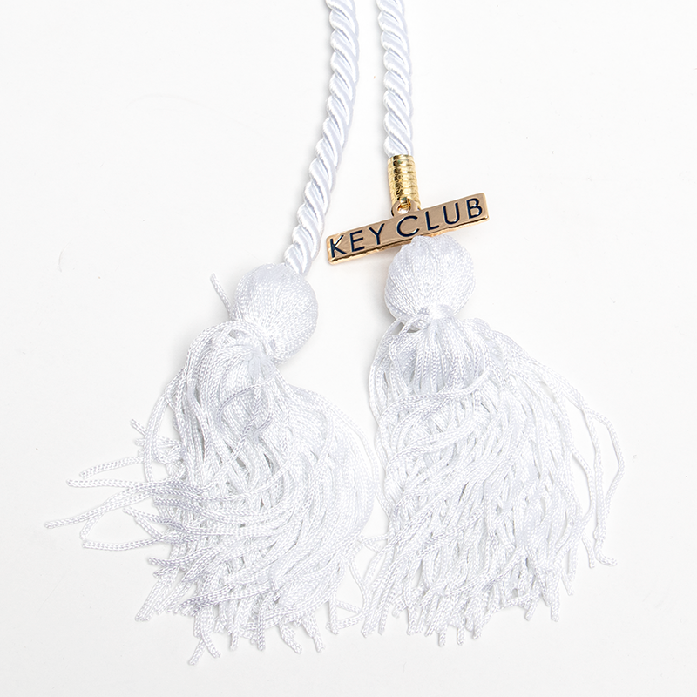
Senior Chord Applications
TURN IN SENIOR CHORD APLICATIONS BY APRIL 11th
Mckenna

Slide 10
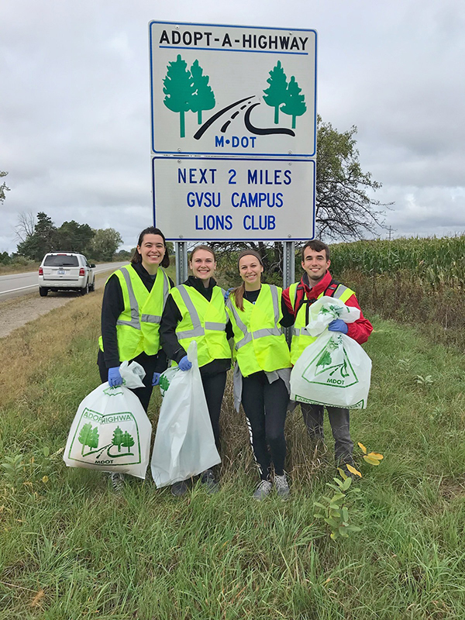
Adopt A Road
April 15th
9AM
20 Spots for 1 hour
Required Form Signed by Parent (Pick up in office)
Turn in by the day of the event
NO FORM = NO HOUR
Lindsey

Slide 11
Member Feedback Form
Eliana

Slide 12
Members of the Month
Tiana
Marenah
Rima
Alsudani
McKenna

Slide 13
Nomination Process
President
Vice president
Secretary
Historian
Go over process together !!!
Lindsey

Slide 14
Teacher Appreciation Cards
Examples of messages:
Thanks for being a great teacher!
I'm so glad to have been your student this year.
Thanks for all your hard work and dedication.
Be thoughtful and put effort into the cards
Julia

Slide 15
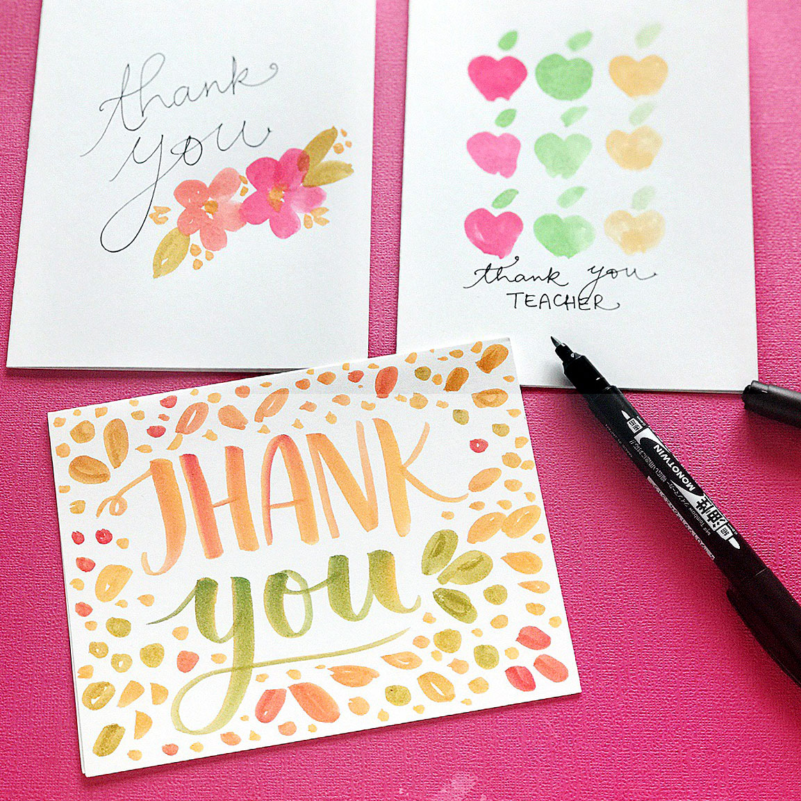
Split Up in Groups
Teacher Appreciation Cards
Our next meeting is Tuesday,
APRIL 11th
Kendyl

Slide 16
Follow Our Socials!!
Check Out our website at dakotakeyclub.weebly.com
Instagram @DakotaKeyClub
Twitter @DakotaKeyClub
Eliana

